Slide 1
DevOps
By altotech

Slide 2
DevOps
What’s DevOps
DevOps Core Value: CAMS
DevOps Principle: The Three ways
DevOps playbook
Ten Practices for DevOps Success
Basic

Slide 3

What is DevOps?
DevOps is the practice of operations and development engineers participating together through the entire service lifecycle, from the design and development process all the way to production support.

Slide 4
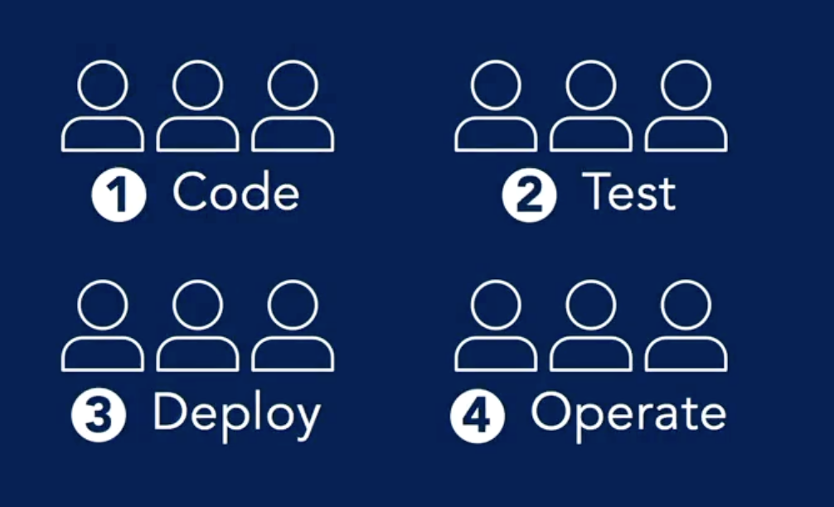

Slide 5
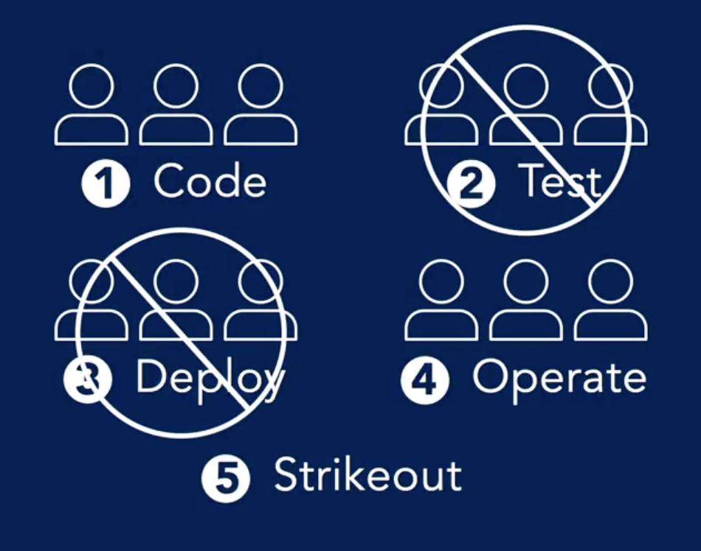

Slide 6
The Five levels of DevOps
Values
Principles
Methods
Practices
Tools

Slide 7
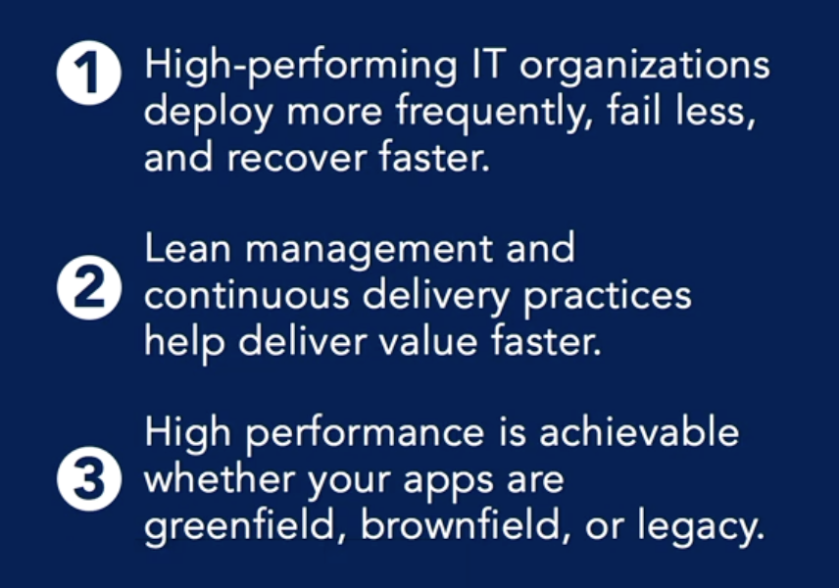
What does DevOps do for you?

Slide 8
Define “Dev and Ops”
Dev is traditionally understood to mean everyone usually on the code side, from developers to front-end designers to QA.
Ops is generally understood to include everyone traditionally on the system side, whether that's Linux administrators or network admins.

Slide 9
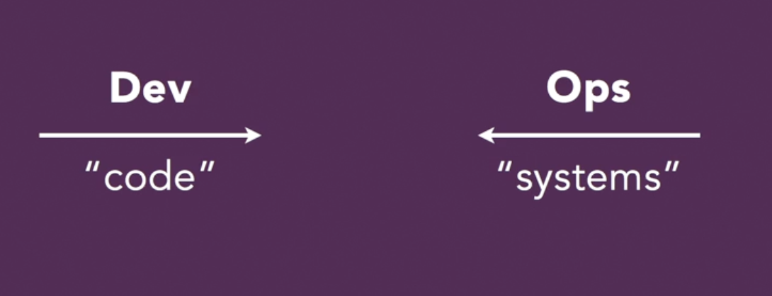

Slide 10
DevOps Value
Culture
Automation
Measurement
Sharing
CAMS

Slide 11
DevOps Value - CAMS
“That the word DevOps gets reduced to technology is a manifestation of how badly we need a cultural shift.” - Patrick Deboise
While DevOps is often thought of as a technology problem, in reality, it's a cultural and business problem.

Slide 12
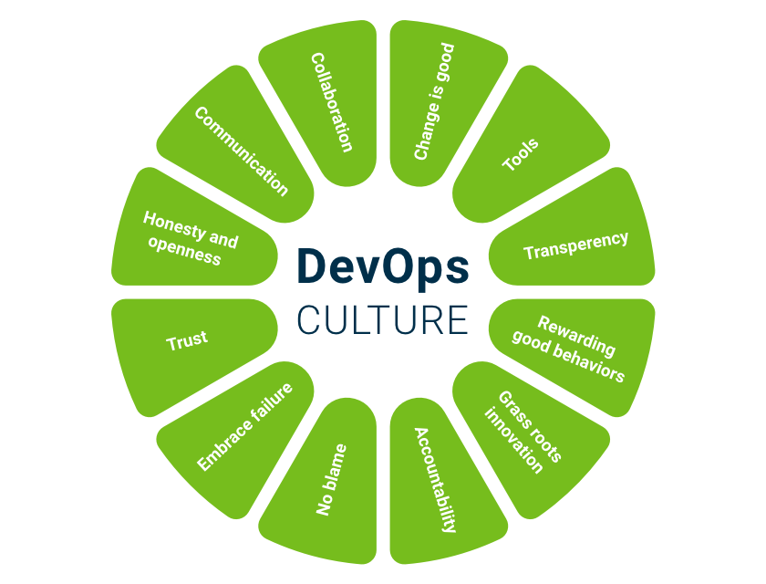
CAMS: Culture
Culture's a lot more than ping pong tables in the office, or free food in the company cafeteria. Culture is driven by behavior. Culture exists among people with a mutual understanding of each other and where they're coming from.

Slide 13
CAMS: Culture
Early on in IT organizations, we split teams into two major groups: Development, they were charged with creating features. And Operations, they were charged with maintaining stability.
Walls formed around these silos due to their differing goals. Now, today after this pattern has had a long time to metastasize, these groups don't speak the same language, and they don't have mutual understanding.

Slide 14
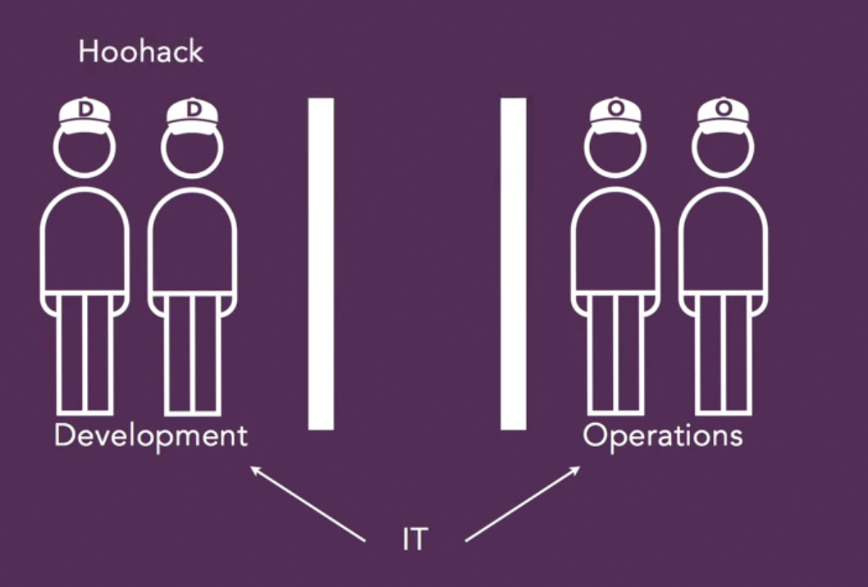
CAMS: Culture

Slide 15
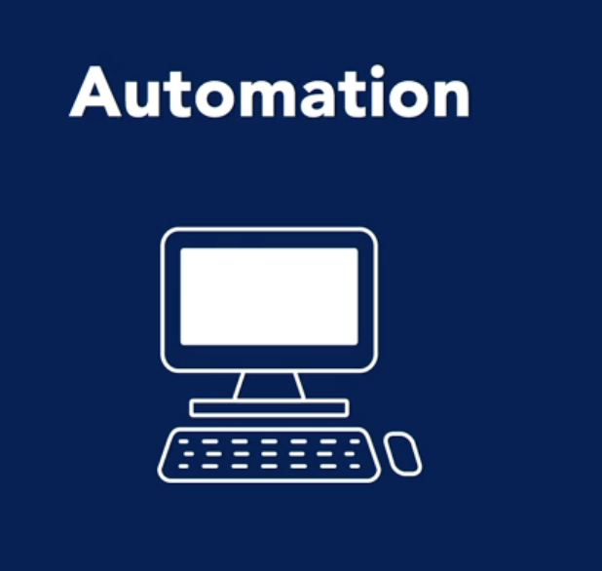
CAMS: Automation
That's 'Automation'. The first thing that people usually think about when they think of DevOps is Automation. In the early days of DevOps, some people coined the term to anybody who was using Chef or Puppet or CFEngine. But part of the point of CAMS is to bring back balance into how we think about it.

Slide 16

CAMS: Automation

Slide 17
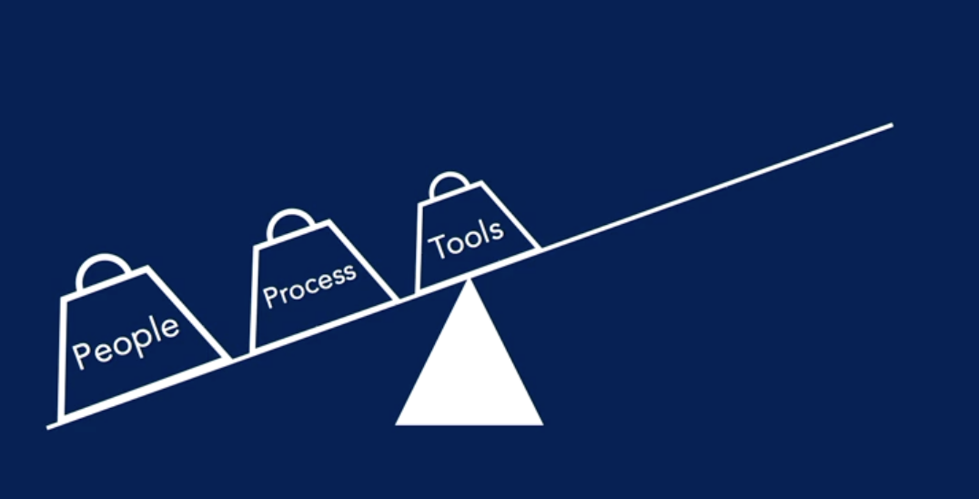
CAMS: Automation
DevOps is not just about automated tooling. People and process, they've got to come first.

Slide 18
CAMS: Automation
Damon Edwards expressed this as "people over process over tools".
All of that said, Automation is a critical part of our DevOps journey. Once you begin to understand your culture, you can create a fabric of automation that allows you to control your systems and your applications.
Automation is that accelerator that's going to get you all the other benefits of DevOps. You really want to make sure you prioritize Automation as your primary approach to the problem.

Slide 19
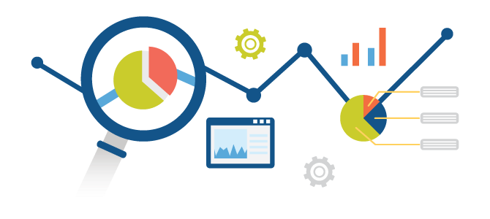
CAMS: Measurement
'M' in CAMS. That stands for 'Measurement'. One of the keys to a rational approach to our systems is the ability for us to measure them.
Metrics, they tell you what's happening and whether the changes that we've made have improved anything.

Slide 20
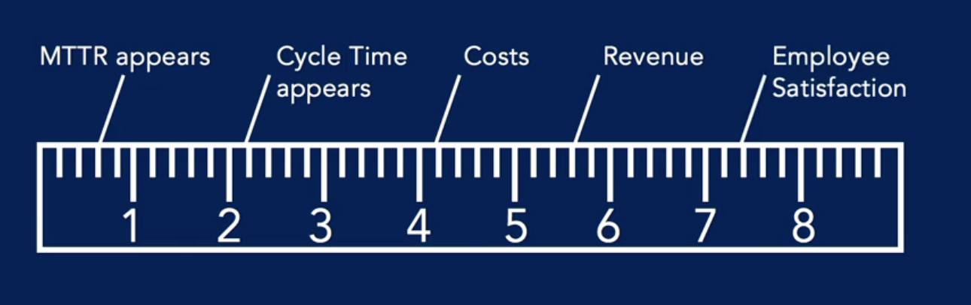
CAMS: Measurement
First, sometimes we choose the wrong metrics to watch.
Second, we fail to incentivize them properly. Because of this, DevOps strongly advises you to measure key metrics across the organization. Look for things like MTTR, the mean time to recovery, or Cycle Time. Look for costs, revenue, even something like employee satisfaction.

Slide 21
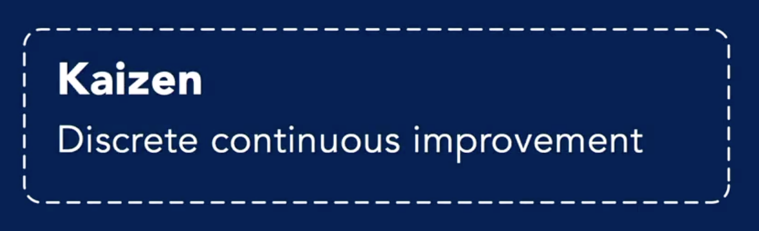
CAMS: Sharing
Sharing ideas and problems is the heart of collaboration. And it's also really at the heart of DevOps. In DevOps, expect to see a high premium placed on openness and transparency. This drives Kaizen, which is a Japanese word that means 'discrete continuous improvement'.

Slide 22
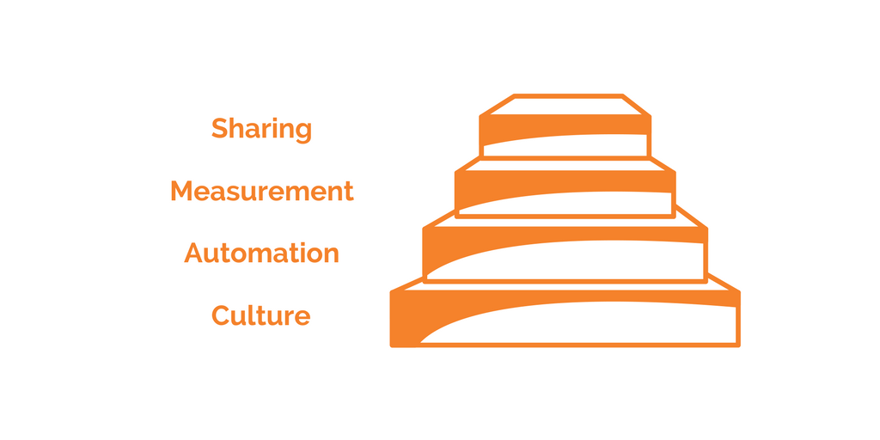
CAMS
CAMS that's 'Culture, Automation, Measurement, and Sharing'. They're the four fundamental and mutually reinforcing values to bring to a DevOps implementation. They're the "why" behind many of the more-specific techniques.

Slide 23
DevOps Principles

Slide 24
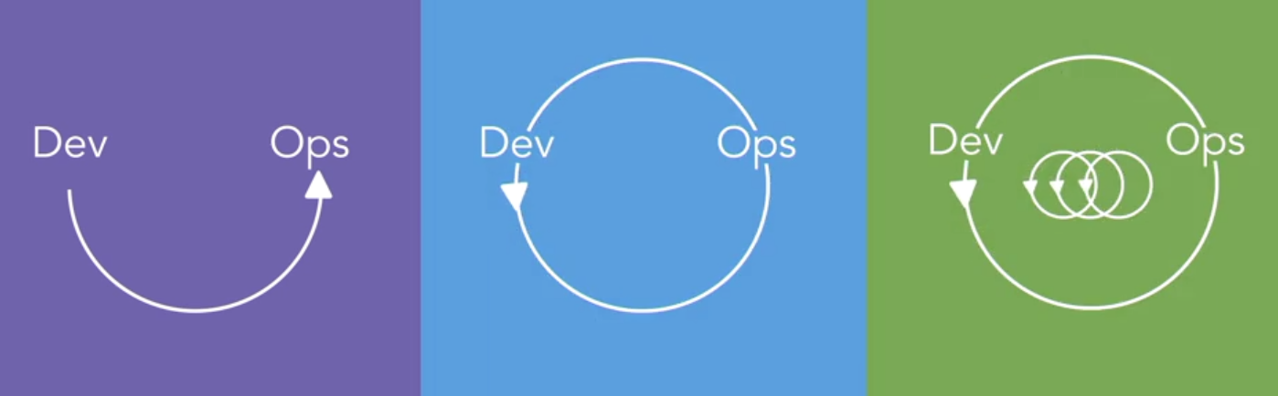
DevOps Principles - The three ways

Slide 25
DevOps Principles - The three ways
The most respected set of principles is called The Three Ways.
This model was developed by Gene Kim, author of "Visible Ops" and "The Phoenix Project," and Mike Orzen, author of "Lean IT."
The three ways they propose are systems thinking, amplifying feedback loops, and a culture of continuous experimentation and learning.

Slide 26
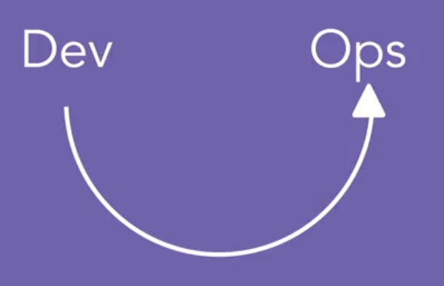
The 3 ways: 1st

Slide 27
The 3 ways: 1st
Systems thinking, tells us that we should make sure to focus on the overall outcome of the entire pipeline in our value chain.
It's easy to make the mistake of optimizing one part of that chain at the expense of overall results. When you're trying to optimize performance in an application, for example, increasing performance or system resources in one area causes the bottleneck to move sometimes to an unexpected place.
You have to understand the whole system to optimize it well.

Slide 28
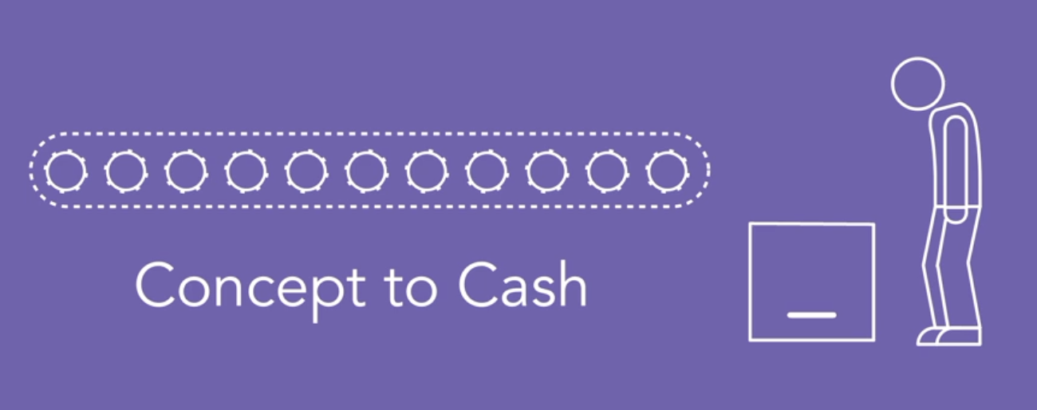
The 3 ways: 1st
If you write all the software in the world but you can't deliver it to a customer in a way that they can use it, you lose.

Slide 29
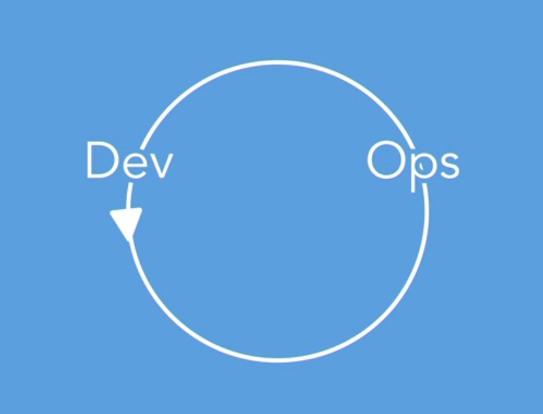
The 3 ways: 2nd

Slide 30
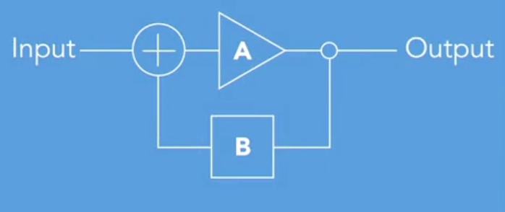
The 3 ways: 2nd
The second way, amplifying feedback loops, is all about creating, shortening, and amplifying feedback loops between the parts of the organization that are in the flow of that value chain. A feedback loop is simply a process that takes its own output into consideration when deciding what to do next.

Slide 31


Slide 32
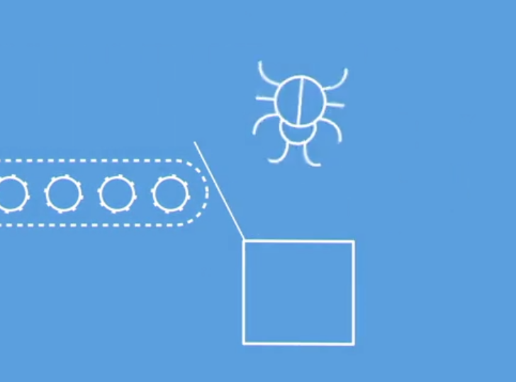

Slide 33
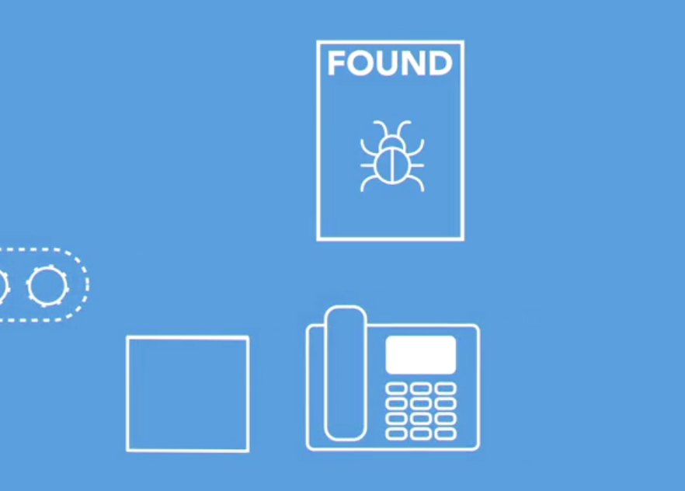

Slide 34


Slide 35


Slide 36
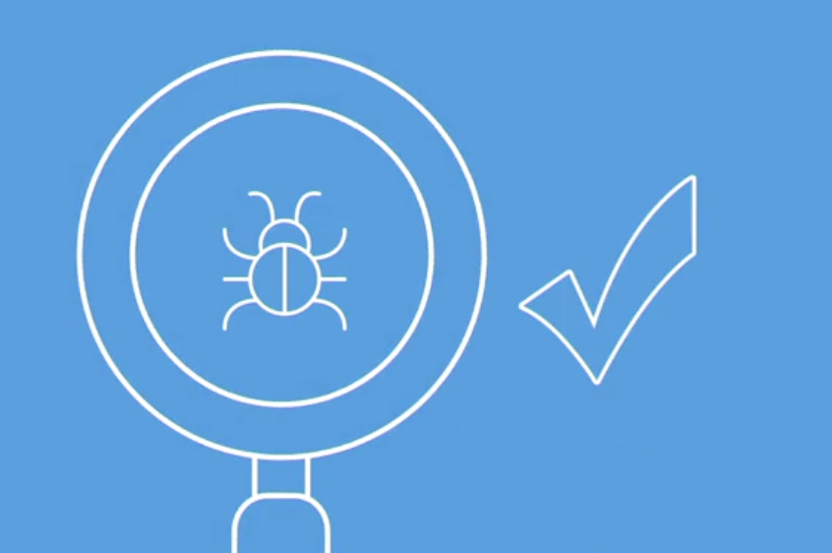

Slide 37
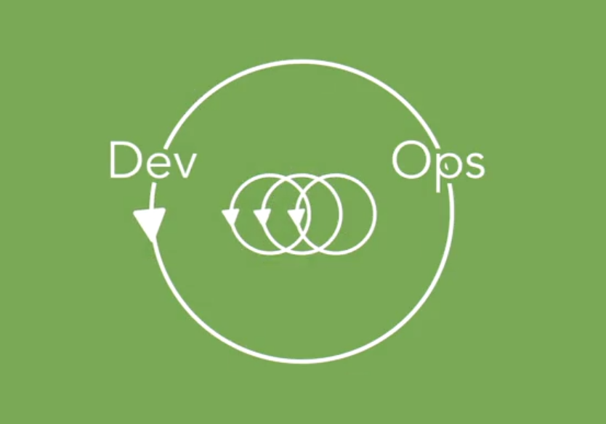
The 3 ways: 3rd

Slide 38
The 3 ways: 3rd
The third way reminds us to create a work culture that allows for both continuous experimentation and learning.
You and your team should be open to learning new things and the best route to that is actively trying them out to see what works, and what doesn't work, instead of falling into analysis paralysis.

Slide 39
The 3 ways: 3rd
Encourage sharing and trying new ideas.
Engineers are problem-finders and problem-solvers by nature, and that can often turn into negativity about new technologies or avoiding attempts to try new things, from "Not Invented Here" Syndrome, to deliberate attempts at niche protection. Acknowledge and overcome these temptations on your path to excellence.
No technology, not even new wiz-bang technologies like Docker or Amazon Web Services, is a silver bullet that solves all of your problems.

Slide 40
The 3 ways: 3rd
USE
To create team processes
To create team standards
As part of management style

Slide 41
DevOps Playbooks

Slide 42
DevOps Playbooks
In Agile, there are defined methodologies like SCRUM and Extreme Programming that provide a playbook for implementing Agile in an organization.
In DevOps, there aren't as many that are well established, but some common methodologies have emerged.
we're covering the five most prevalent DevOps methodologies.

Slide 43
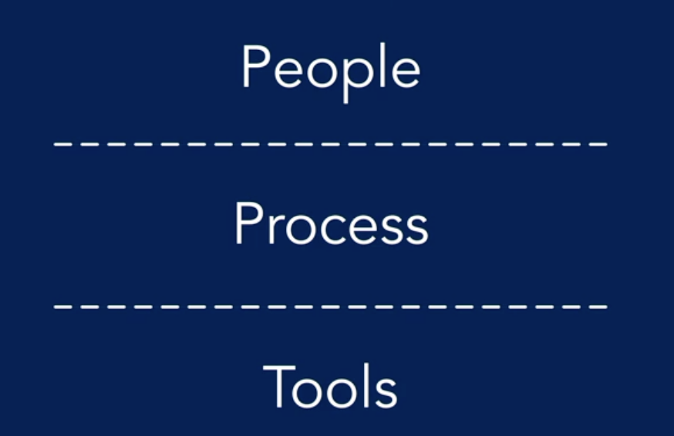
Playbooks: People over Process

Slide 44
Playbooks: People over Process
People over process over tools
Identifying who's responsible for a job function first.
Then defining the process that needs to happen around them.
And then selecting and implementing the tool to perform that process.

Slide 45
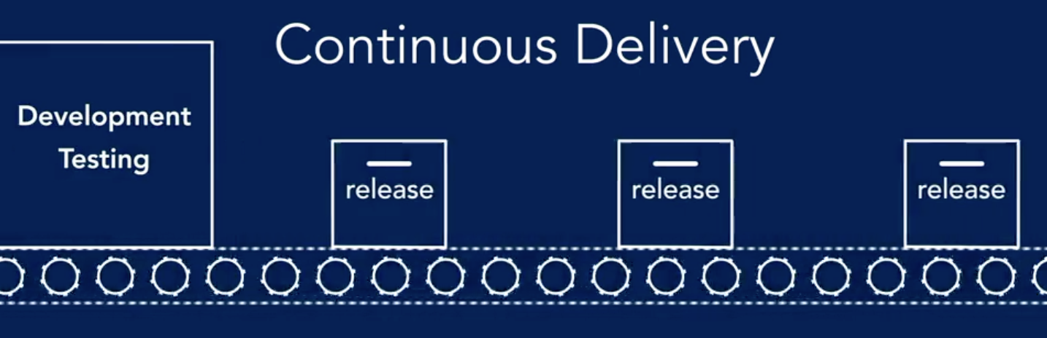
Playbooks: Continuous Delivery

Slide 46
Playbooks: Continuous Delivery
It's such a common methodology that some people even wrongly equate it with DevOps.
In short, it's the practice of coding, testing, and releasing software frequently, in really small batches so that you can improve the overall quality and velocity.
It's been shown in studies that in CD environments, the team spends 22% less time on unplanned work and rework. Changes have a three times lower failure rate and the team recovers 24 times faster from failures. - And it works for all kinds of load workloads, even legacy environments.

Slide 47
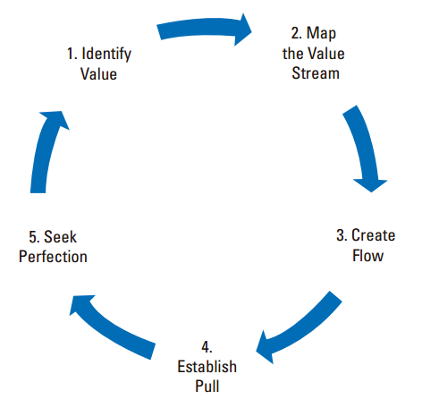
Playbooks: Lean Management
Work in small batches
Work in progress limits
Feedback loops
Visualization

Slide 48
Playbooks: Change Control
Eliminate fragile artifacts
Create a repeatable build process
Manage dependencies
Create an environment of continuous improvement

Slide 49
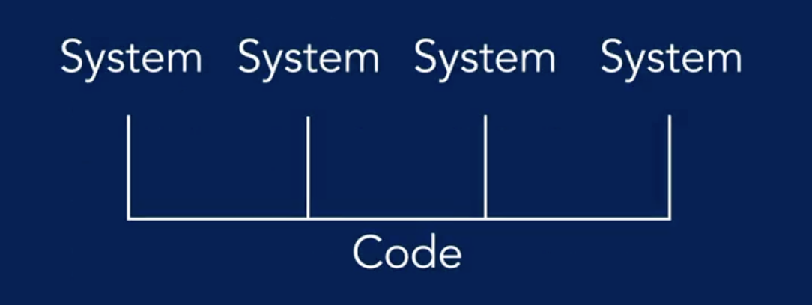
Playbooks: IAAS (Infrastructure as a Code)
Systems treated like code
Checked into source control
Reviewed, build, and tested
Managed programmatically

Slide 50
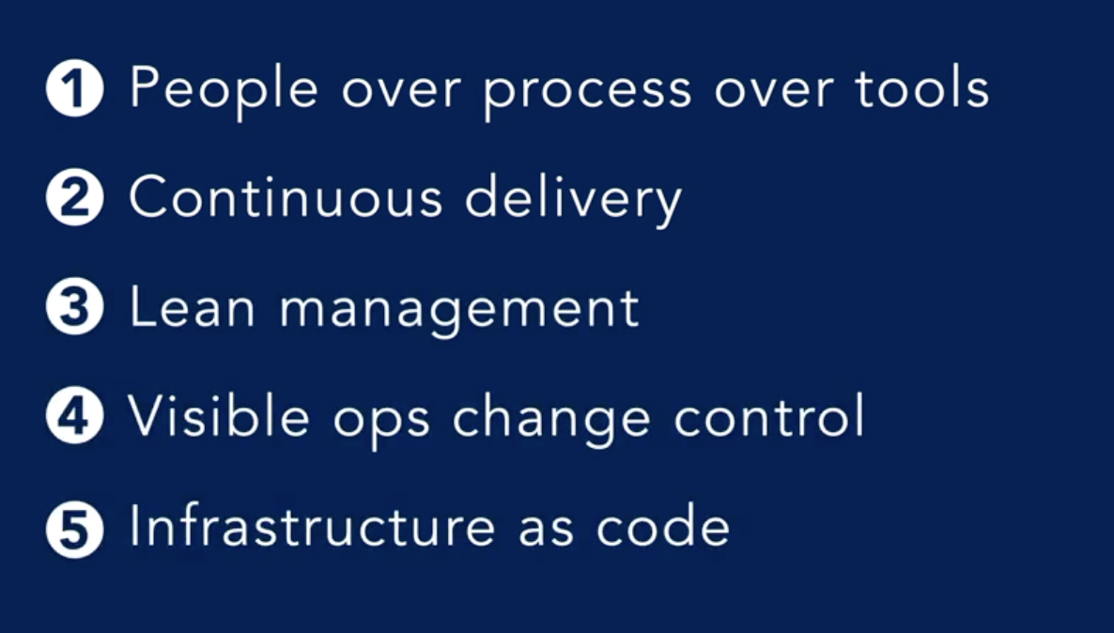
Playbooks
Conclusion

Slide 51
Ten Practices for DevOps Success

Slide 52
Practices: #10 ICS
Incident command system.
The Incident Command System (ICS) is a standardized approach to the command, control, and coordination of emergency response providing a common hierarchy within which responders from multiple agencies can be effective.

Slide 53
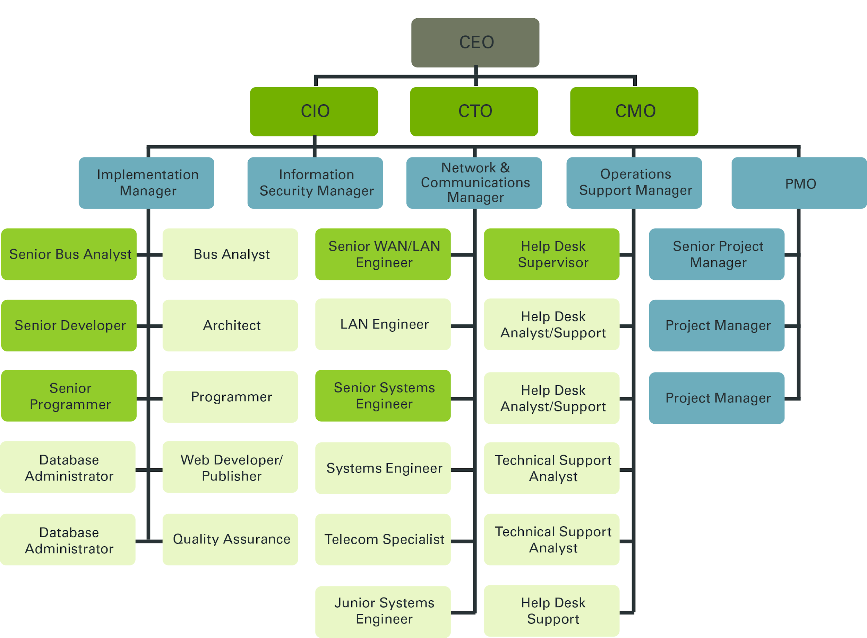
Practices: #10 ICS

Slide 54
Practices: #9 Developers On Call
Most IT organizations have approached applications with the philosophy of, let's make something. And then someone else will be responsible for making sure it works. Needless to say, this hasn't worked out so well.
Teams have begin putting developers on call for the service they created. This creates a very fast feedback loop. Logging and deployment are rapidly improved and core application problems get resolved quickly, instead of lingering for years while making some network operations center person re-start the servers as a work-around.

Slide 55
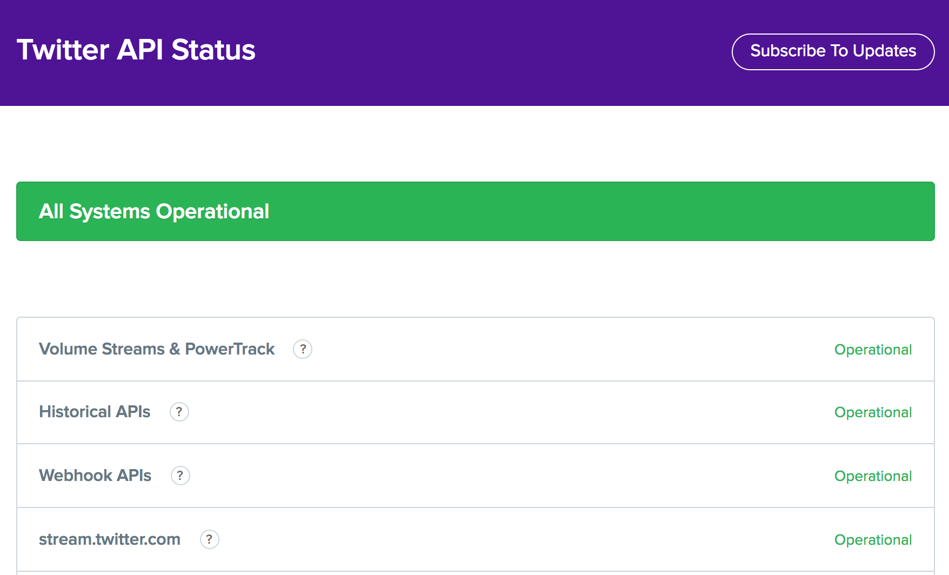
Practices: #8 Public Status Pages
Services go down, they have problems. It's a fact of life.
The only thing that's been shown to increase customer satisfaction and retain trust during these outages, is communication.

Slide 56
Practices: #7 Blameless Postmortems
Decades of research on industrial safety has disproven the idea, that there's a single root cause for an incident, or that we can use human error as an acceptable reason for a failure. - John Allspaw, CTO at Etsy
Blameless Postmortems and A Just Culture, an article, on how to examine these failures and learn from them while avoiding logical fallicies, or relying on scapegoating, to make ourselves feel better while making our real situation worse.

Slide 57
Practices: #6 Embedded Teams
Dev team wants to ship new code and the Ops team wants to keep the service up.
Inside of that, there's an inherent conflict of interest.
Some teams reorganize to embed an operations engineer on each development team and make the team responsible for all it's own work, instead of throwing requests over the wall into some queue for those other people to do.

Slide 58
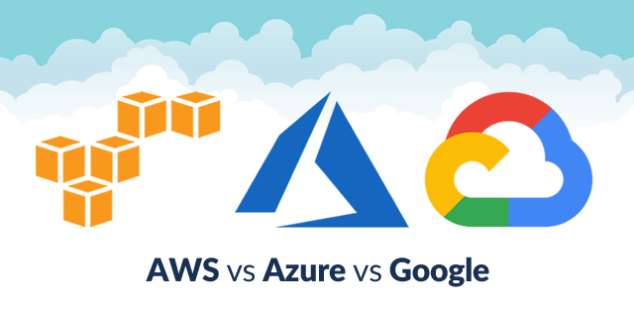
Practices: #5 The cloud
Cloud solutions give you an entirely API driven way to create and control infrastructure. - This allows you to treat your systems infrastructure exactly as if it were any other program component.
The cloud approach to infrastructure can make your other devops changes move along at high velocity.

Slide 59

Practices: #4 Addon Cords
Frequently in a devops environment you're releasing quickly. Ideally, you have automated testing that catches most issues, but tests aren't perfect.
Notes:
Toyota case on production

Slide 60
Practices: #4 Addon Cords
Halt an upgrade or deployment to stop the bug from propagating downstream.
We recently added an Andon Cord to our build system. After a developer released a bug to production that he knew about but didn't have a test to catch. Now, everyone can stop ship if they know something's not right.

Slide 61
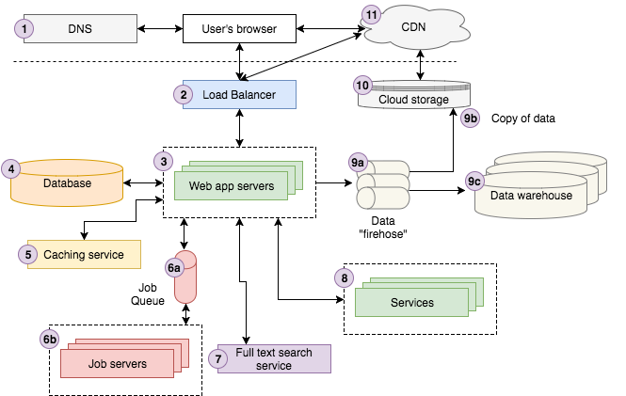
Practices: #3 Dependency Injection
In a modern application connections to it's external services, like databases or rest services, etc, they're the source of most of the run-time issues.

Slide 62
Practices: #3 Dependency Injection
Dependency injection, or sometimes called inversion of control. This focuses on loosely coupled dependencies.
In this pattern the application shouldn't know anything about it's external dependencies. Instead, they're passed into the application at run-time. This is very important for a well-behaved application in an infrastructure as code environment.

Slide 63
Practices: #2 Blue/Green Deployment
Instead of testing a release in a staging environment and then deploying it to a production environment and hoping it works
You should have Two identical systems, blue and green. One is live and the other isn't. To perform an upgrade, you upgrade the offline system, test it, and then shift production traffic over to it.
If there's a problem you shift back. This minimizes both downtime from the change itself and risk that the change won't work when it's deployed to production.

Slide 64
Practices: #1 The Chaos Monkey
Netflix is one of the leading companies in new-style technology management, and to ensure they were doing reliability correctly, they invented a piece of software called the Chaos Monkey.
Chaos Monkey watches the Netflix system that runs in the Amazon cloud, and occasionally reaches out and trashes a server. Just kills it. This forces the developers and operators creating the systems, to engineer resiliency into their services, instead of being lulled into making the mistake of thinking that their infrastructure is always on.

Slide 65
DevOps Tools

Slide 66
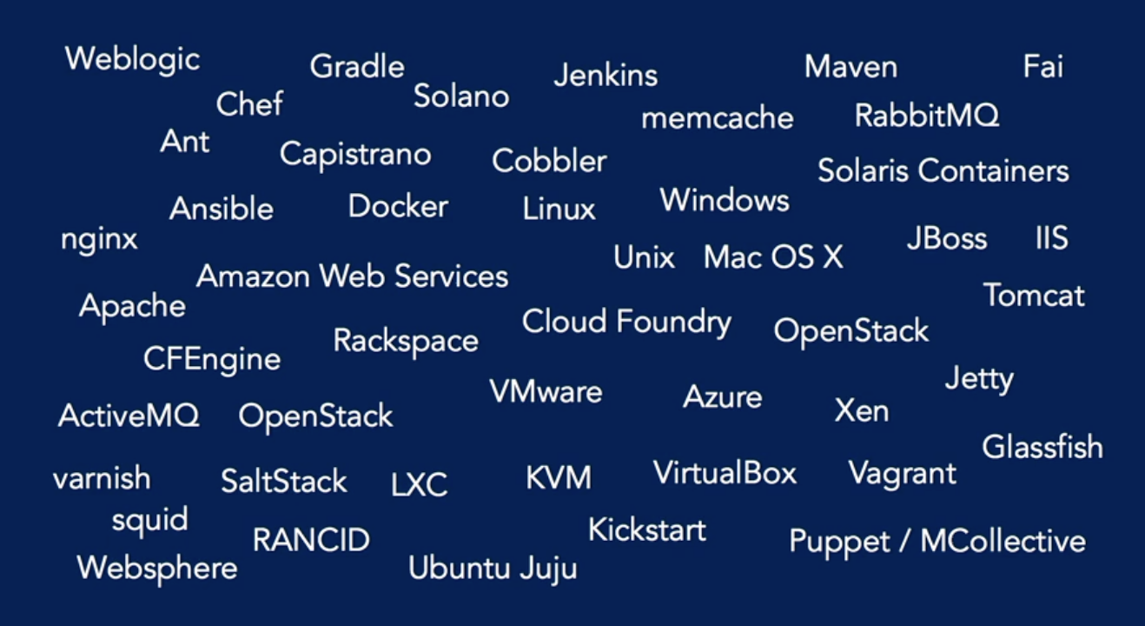
DevOps: Tools

Slide 67
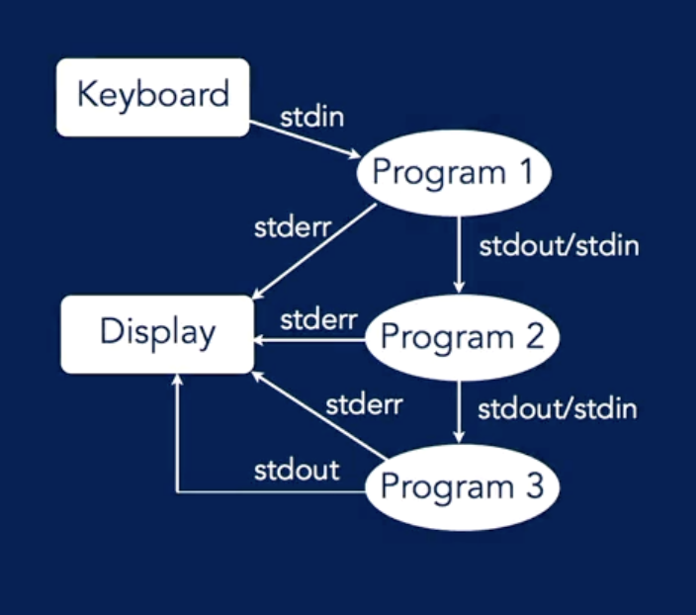
Tools: Toolchain
DevOps toolchain is a set or combination of tools that aid in the delivery, development, and management of applications throughout the systems development life cycle.

Slide 68
Tools: Criteria
Programmable
Verifiable
Well behaved

Slide 69
DevOps
Infrastructure As A Code
Configuration Management
Immutable Deployment
Your Infrastructure toolchain
Infrastructure Automation

Slide 70
Infrastructure As
A
Code

Slide 71
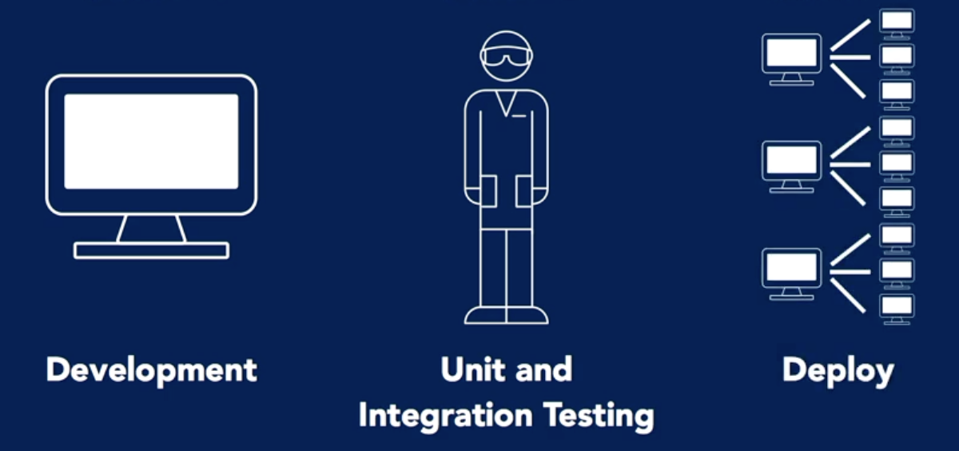
IAAS

Slide 72
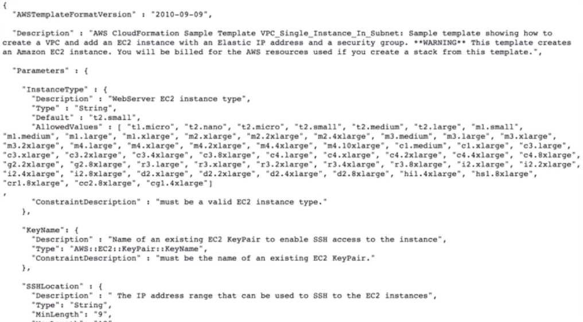
IAAS: Simple Template for AWS CloudFormation

Slide 73
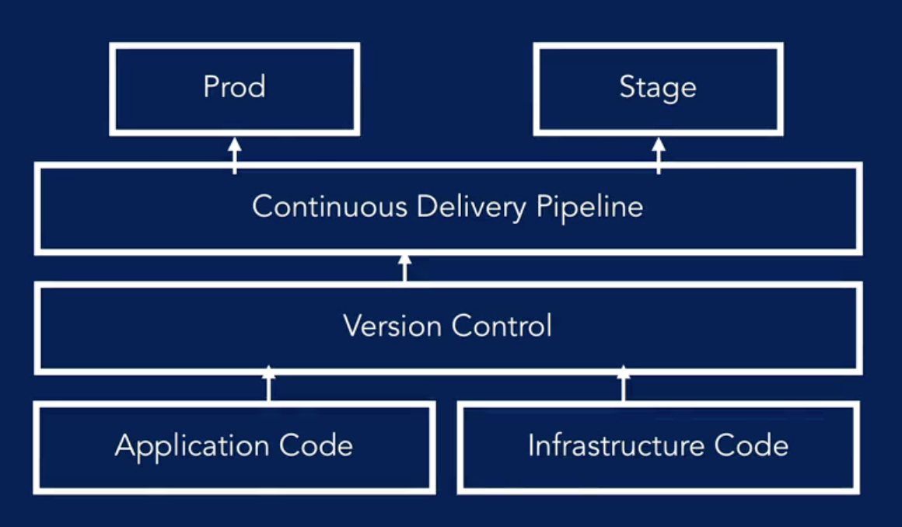
IAAS: Environment

Slide 74
Configuration
Management

Slide 75
CM: Getting to know the terms
Provisioning: Making a server ready for operation, including hardware, OS, system services, and network connectivity.
Deployment: Automatically deploying and upgrading applications on a server.
Orchestration: Performing coordinated operations across multiple systems.

Slide 76
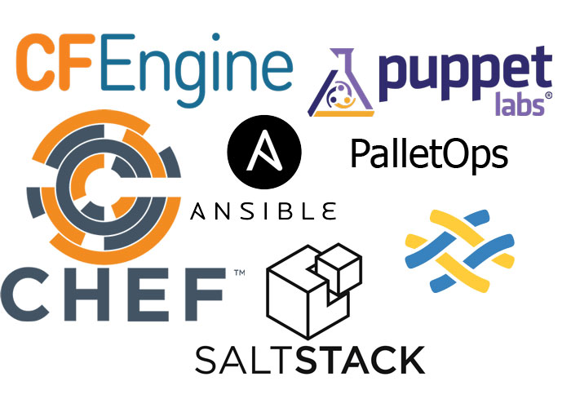
CM: Getting to know the terms
Configuration Management: Management of change control for system configuration after initial provision; maintaining and upgrading the application and application dependencies.

Slide 77
CM: Getting to know the terms
Imperative/procedural: Commands necessary to produce a desired state are defined and executed.
Declarative/functional: A desired state is defined, relying on the tool to configure a system to match that state.
Idempotent: The ability to execute repeatedly, resulting in the same outcome.
Self service: The ability for an end user to initiate a process without having to go through other people

Slide 78
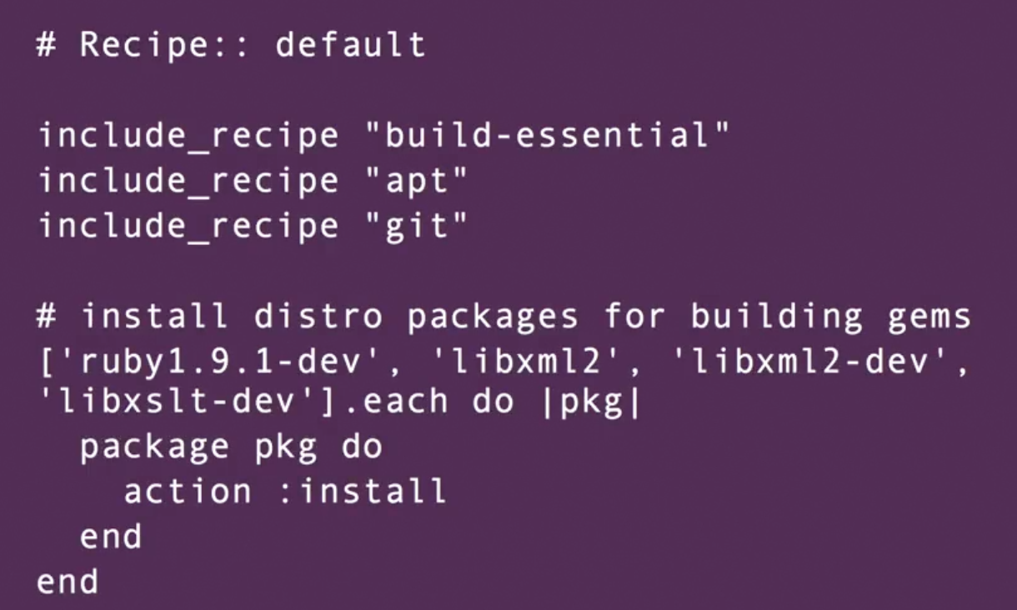
CM: Example of configuration recipe

Slide 79
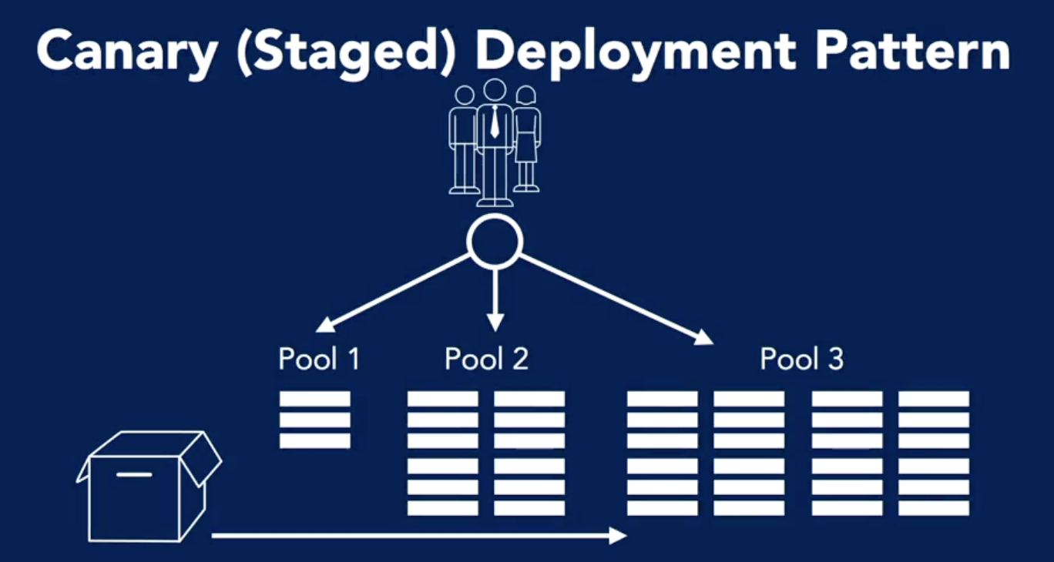
CM: Deployment Pattern
Upgrade 1 server and see how it works before upgrading other servers

Slide 80
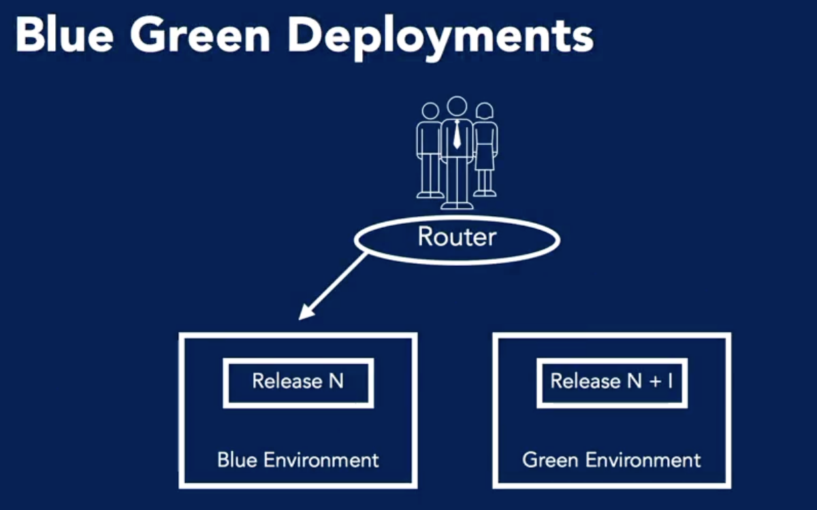
CM: Deployment Pattern

Slide 81
Immutable Deployment

Slide 82
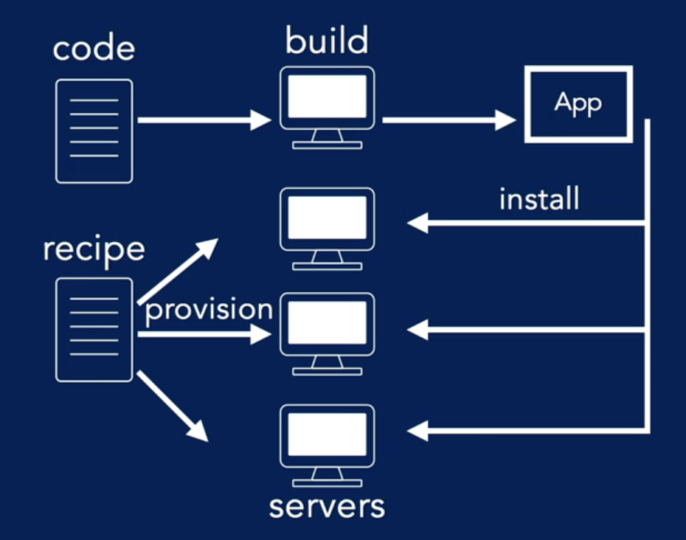
Immutable Deployment

Slide 83
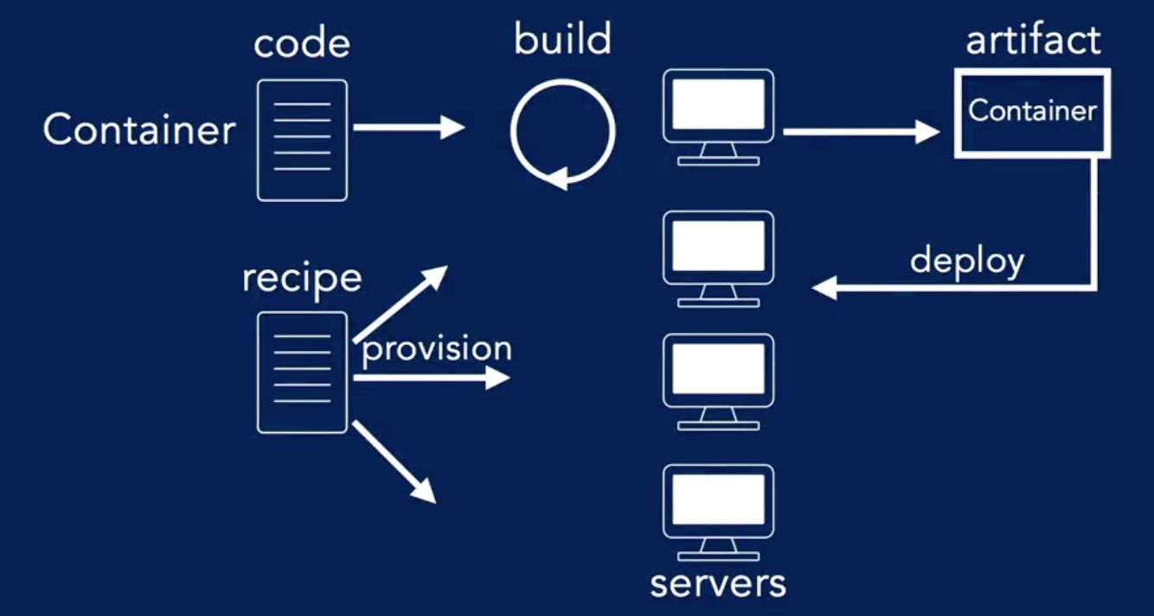
Immutable Deployment

Slide 84
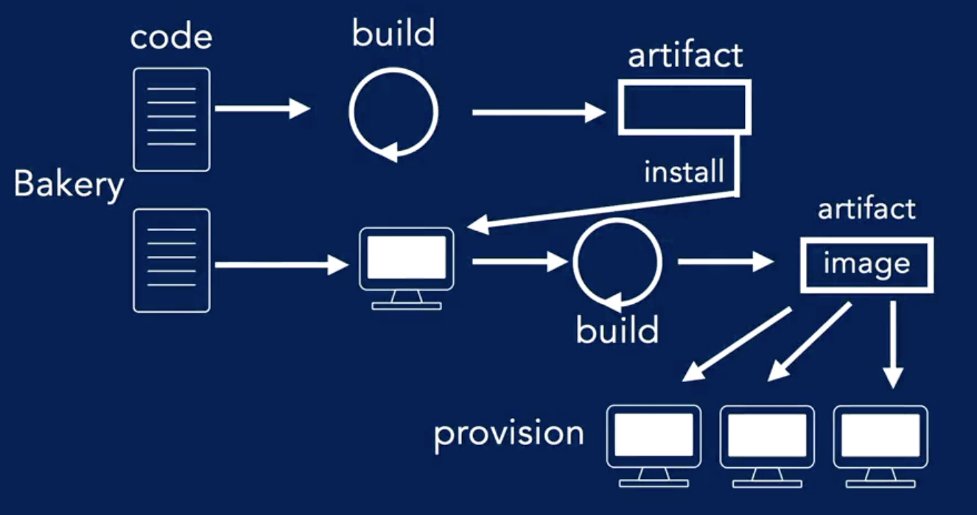
Immutable Deployment

Slide 85
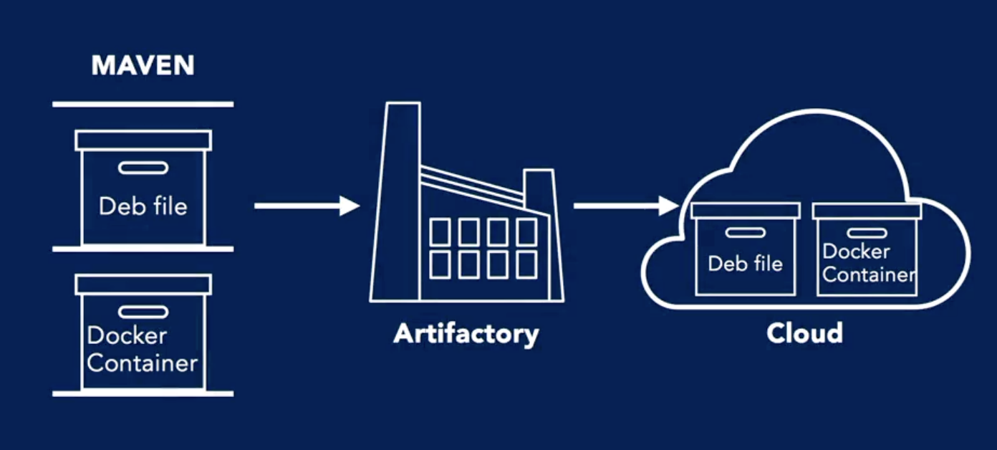
Immutable Deployment

Slide 86
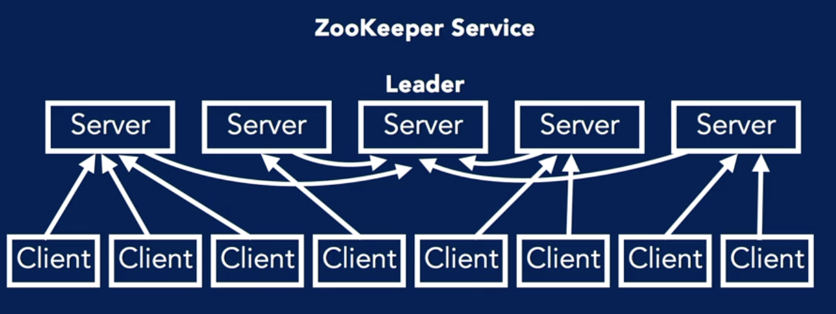
Immutable Deployment

Slide 87
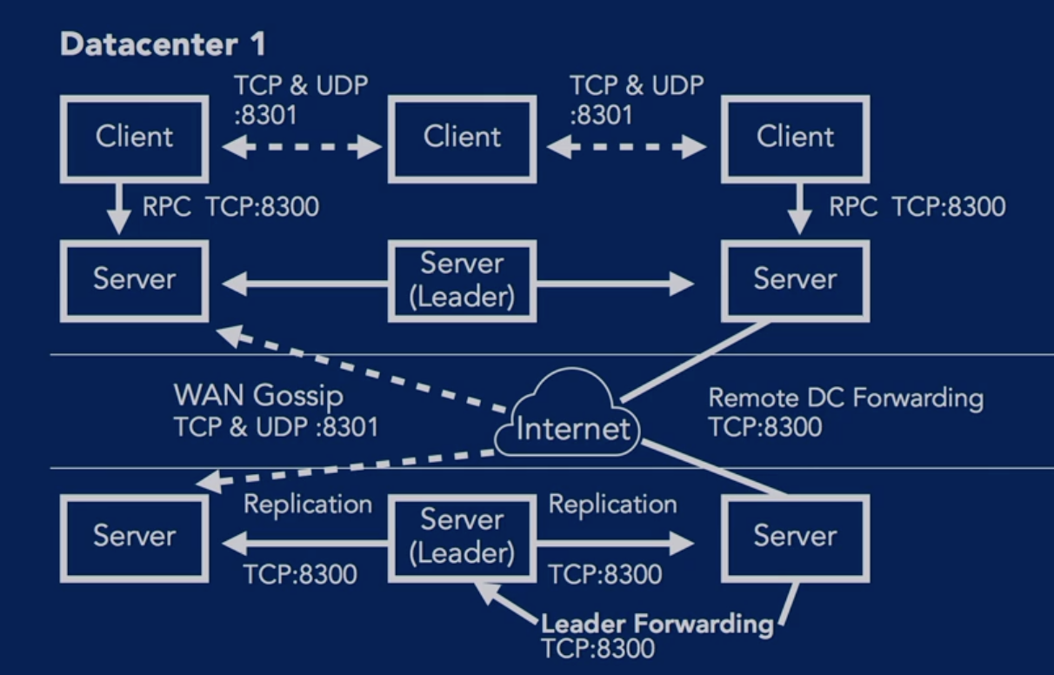
Immutable Deployment

Slide 88
Infrastructure
Toolchain

Slide 89
Toolchain
for
Resource

Slide 90
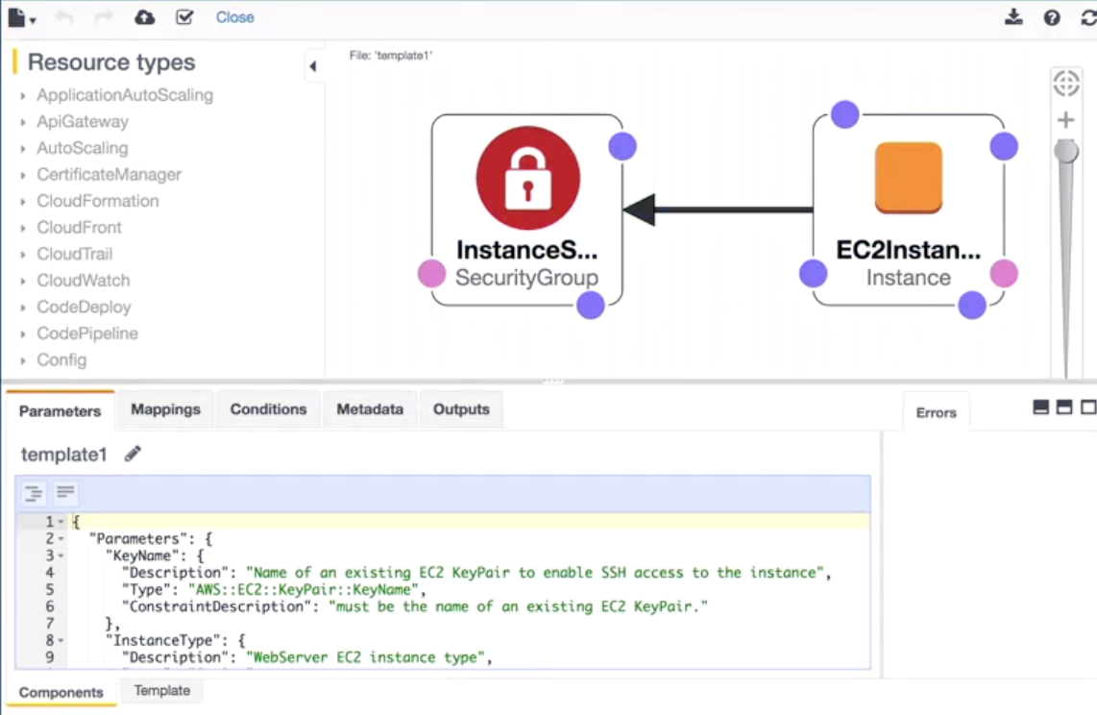
Toolchain: AWS

Slide 91
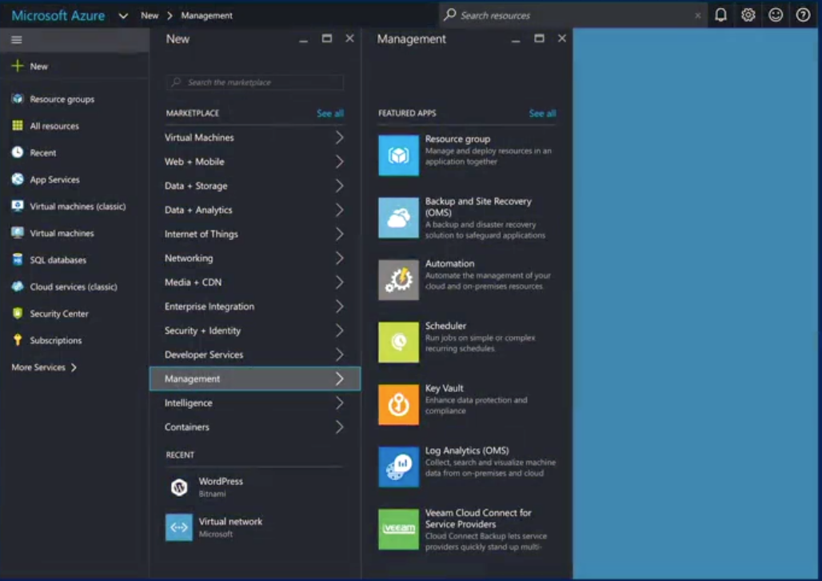
Toolchain: Azure Resource Management

Slide 92
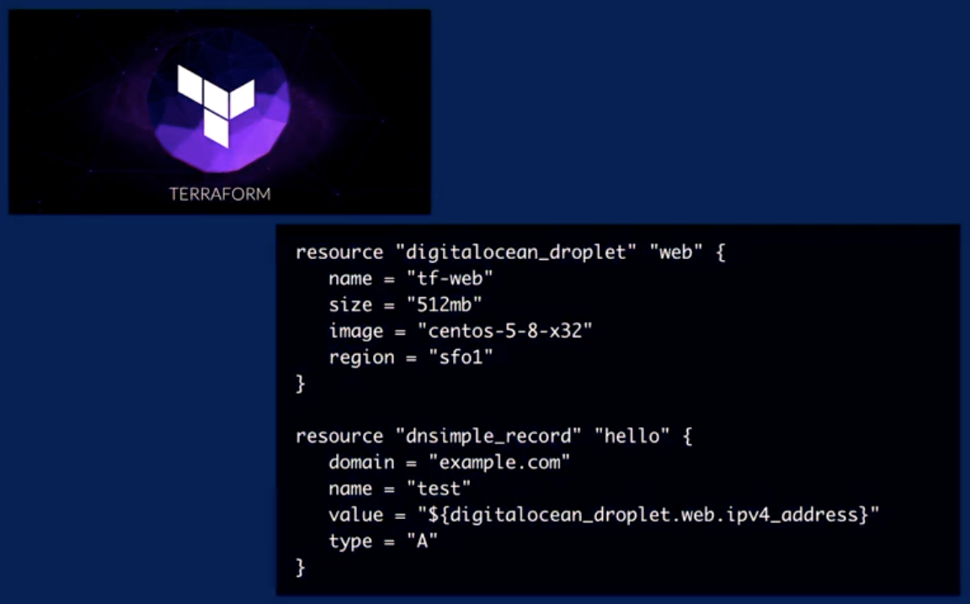
Toolchain: Hashicorp’s TERRAFORM

Slide 93
Toolchain
for
Configuration

Slide 94
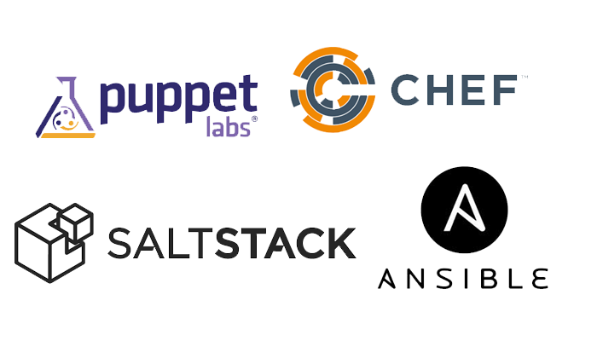
Toolchain: Configuration Management
Chef
Puppet
Ansible
Salt
Packer

Slide 95
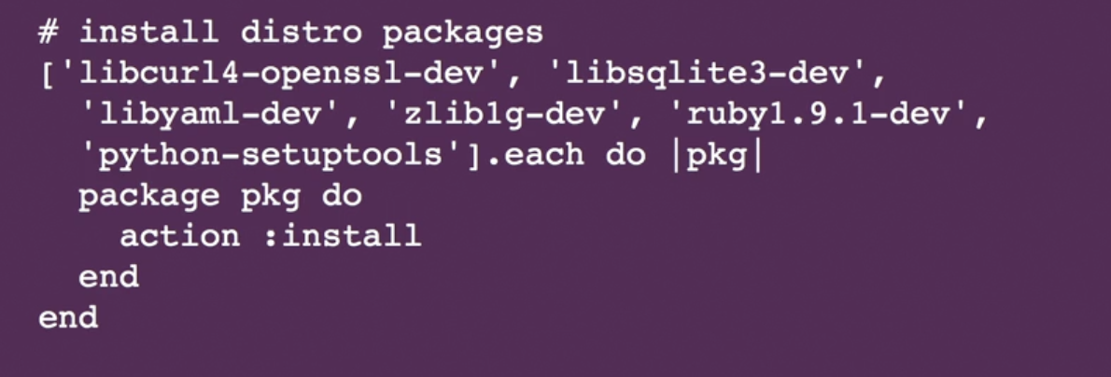
Toolchain: Configuration Management
Sample Chef code

Slide 96
Toolchain
for
Service directory

Slide 97

Toolchain: Service Directories
Etcd
ZooKeeper
Consul
SkyDNS
Eureka

Slide 98
Toolchain
for
Orchestration

Slide 99

Toolchain: Orchestration
Docker Swarm
K8S
Apache Mesos

Slide 100
DevOps
Continuous Delivery
Continuous Integration Practices
CI Pipelines
The role of QA
CI toolchain
Continuous Delivery

Slide 101

DevOps
DevOps is the union of people, process, and products to enable continuous delivery of value to our end users. The contraction of “Dev” and “Ops” refers to replacing siloed Development and Operations to create multidisciplinary teams that now work together with shared and efficient practices and tools. Essential DevOps practices include agile planning, continuous integration, continuous delivery, and monitoring of applications.

Slide 102

DevOps - Understand your Cycle Time
You start with observation of business, market, needs, current user behavior, and available telemetry data. Then you orient with the enumeration of options for what you can deliver, perhaps with experiments. Next you decide what to pursue, and you act by delivering working software to real users. All of this occurs in some cycle time.

Slide 103

DevOps - Strive for Validated Learning
How quickly you can fail fast or double down is determined by how long that loop takes, or in lean terms, by your cycle time. Your cycle time determines how quickly you can gather feedback to determine what happens in the next loop. The feedback that you gather with each cycle should be real, actionable data. This is called validated learning.

Slide 104

DevOps - Shorten Your Cycle Time
When you adopt DevOps practices, you shorten your cycle time by working in smaller batches, using more automation, hardening your release pipeline, improving your telemetry, and deploying more frequently.

Slide 105

DevOps - Optimize Validated Learning
The more frequently you deploy, the more you can experiment, the more opportunity you have to pivot or persevere, and to gain validated learning each cycle. This acceleration in validated learning is the value of improvement. Think of it as the sum of improvements that you achieve and the failures that you avoid.

Slide 106

DevOps - How to Achieve DevOps > Continuous Integration (CI)
Goal: shorten cycle time.
Question: How long does it take you to deploy a change of one line of code or configuration? Ultimately, that’s the brake on your velocity.
Continuous Integration drives the ongoing merging and testing of code, which leads to finding defects early. Other benefits include less time wasted on fighting merge issues and rapid feedback for development teams.

Slide 107

DevOps - How to Achieve DevOps > Continuous Delivery (CD)
Goal: shorten cycle time.
Question: How long does it take you to deploy a change of one line of code or configuration? Ultimately, that’s the brake on your velocity.
Continuous Delivery of software solutions to production and testing environments helps organizations quickly fix bugs and respond to ever-changing business requirements

Slide 108

DevOps - How to Achieve DevOps > Version Control
Goal: shorten cycle time.
Question: How long does it take you to deploy a change of one line of code or configuration? Ultimately, that’s the brake on your velocity.
Version Control, Usually With Git, enables teams located anywhere in the world to communicate effectively during daily development activities as well as to integrate with software development tools for monitoring activities such as deployments

Slide 109

DevOps - How to Achieve DevOps > Kanban
Goal: shorten cycle time.
Question: How long does it take you to deploy a change of one line of code or configuration? Ultimately, that’s the brake on your velocity.
Agile planning and lean project management techniques are used to plan and isolate work into sprints, manage team capacity, and help teams quickly adapt to changing business needs. A DevOps Definition of Done is working software collecting telemetry against the intended business objectives.

Slide 110

DevOps - How to Achieve DevOps > Monitoring and Logging
Goal: shorten cycle time.
Question: How long does it take you to deploy a change of one line of code or configuration? Ultimately, that’s the brake on your velocity.
Monitoring and Logging of running applications including production environments for application health as well as customer usage, helps organizations form a hypothesis and quickly validate or disprove strategies. Rich data is captured and stored in various logging formats.

Slide 111

DevOps - How to Achieve DevOps > Public and Hybrid Clouds
Goal: shorten cycle time.
Question: How long does it take you to deploy a change of one line of code or configuration? Ultimately, that’s the brake on your velocity.
Public and Hybrid Clouds have made the impossible easy. The cloud has removed traditional bottlenecks and helped commoditize infrastructure. Whether you use Infrastructure as a Service (IaaS) to lift and shift your existing apps, or Platform as a Service (PaaS) to gain unprecedented productivity, the cloud gives you a datacenter without limits.

Slide 112

DevOps - How to Achieve DevOps > Infrastructure as Code
Goal: shorten cycle time.
Question: How long does it take you to deploy a change of one line of code or configuration? Ultimately, that’s the brake on your velocity.
Infrastructure as Code (IaC) is a practice which enables the automation and validation of creation and teardown of environments to help with delivering secure and stable application hosting platforms.

Slide 113

DevOps - How to Achieve DevOps > Microservices
Goal: shorten cycle time.
Question: How long does it take you to deploy a change of one line of code or configuration? Ultimately, that’s the brake on your velocity.
Microservices architecture is leveraged to isolate business use cases into small reusable services that communicate via interface contracts. This architecture enables scalability and efficiency.

Slide 114

DevOps - How to Achieve DevOps > Containers
Goal: shorten cycle time.
Question: How long does it take you to deploy a change of one line of code or configuration? Ultimately, that’s the brake on your velocity.
Containers are the next evolution in virtualization. They are much more lightweight than virtual machines, allow much faster hydration, and can be easily configured from files.

Slide 115

DevOps - Summary

Slide 116

DevOps - Summary

Slide 117

Continuous Delivery

Slide 118
Why Continuous Delivery?
Time to market goes down
Quality increases, not decreases
Limit your work in progress
Shortens lead times for changes
Improves mean time to recover

Slide 119
Continuous Practices

Slide 120

CI Practices: Goal
“The goal of continuous integration is that software is in a working state all the time.” - Jez Humble

Slide 121

CI Practices: Coffee Test
Build Choose Pass the Coffee Test (<5 minutes)

Slide 122

CI Practices: Small bits
Seek to commit the smallest amount of code per commit.
Small changes are much easier for everyone on the team to reason about.

Slide 123

CI Practices: Don’t leave the build Broken
“When you leave the build broken, you block delivery.”

Slide 124

CI Practices: Trunk-based development
All developers work off trunk and commit back to trunk multiple times a day.
Now, instead of keeping separate code branches, developers branch in code and use feature flags.

Slide 125

CI Practices: Fix the flaky test!

Slide 126
CI Practices: Always logging
The build should return a status, a log, and an artifact.
The status should be a simple pass/fail or a red/green.
A build log is a record of all the tests run and all the results of the run.
The artifact should be uploaded and tagged with a build number.

Slide 127
CI Pipeline

Slide 128
CI Pipeline
Only build artifacts once
These artifacts shouldn't be rebuilt for staging, testing, and production environments.
They should be built once and then used in all the environments. This way, you know that your testing steps are valid since they all use the same artifact.

Slide 129
CI Pipeline
Artifacts should be immutable.
Your artifacts also shouldn't be allowed to change along the way.
They need to be stored and have permissions set in such a way that they're immutable.

Slide 130

CI Pipeline

Slide 131
CI Pipeline
Deployment should go to a copy of production.
Your system needs to stop the pipeline if there's breakage at any point.
But even more importantly, the CD pipeline shouldn't allow progression from stage to stage without assurance that the last stage was run successfully.

Slide 132
CI Pipeline
Deployments should be idempotent.
Idempotency is key for your deployments. In other words, redeploying should leave your system in the same state.

Slide 133
The role of QA

Slide 134
Testing
Types
Unit testing
Code hygiene
Integration testing
Security testing
TDD/BDD/ATDD
Infrastructure testing
Performance testing

Slide 135


Testing: Unit test

Slide 136

Testing: Code Hygiene

Slide 137

Testing: TDD/BDD/ATDD

Slide 138
Testing: BDD
Behaviour-Driven Development
Work with stakeholders
Describe business functionality
Tests are based on natural language descriptions.

Slide 139
Testing: BDD Example
Featured: SUM
Given I have a calculator
When i give it two numbers to add
Then it should return their sum

Slide 140

Testing: ATDD
Acceptance-Test-Driven Development
End user perspective
Use case automated testing
Testing is continuous during development.

Slide 141
Testing: Techniques for Dealing with Slow Tests
Use non blocking tests in your pipeline
Use time-scheduled testing (aka a nightly test suite)
Use monitoring to accomplish some test goals.

Slide 142
CI toolchain

Slide 143

CI Toolchain

Slide 144

CI Toolchain: Version Control

Slide 145

CI Toolchain: CI system
Jenkins

Slide 146


CI Toolchain: Build
make/rake
Maven
Gulp

Slide 147


CI Toolchain: Test
Junit
Golint
Robot
Cucumber
Selenium
KitchenCI

Slide 148

CI Toolchain: Artifact Repository
Artifactory
Docker hub
Nexus
AWS S3

Slide 149


CI Toolchain: Deploy
Rundeck
Urbancode
ThoughtWorks
Deployinator

Slide 150
CI Lab

Slide 151
Azure DevOps Lab
https://docs.google.com/presentation/d/1s4cOEjphEI91dM8zmPwy_scM6UpRhzmYFkjnjUawEpw/edit?usp=sharing

